Slide 1
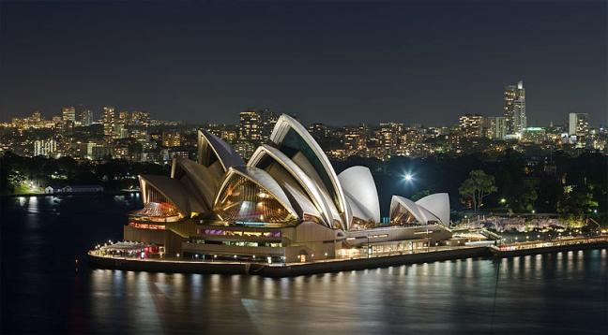
Australia
Teacher: Lebedeva S.P.

Slide 2
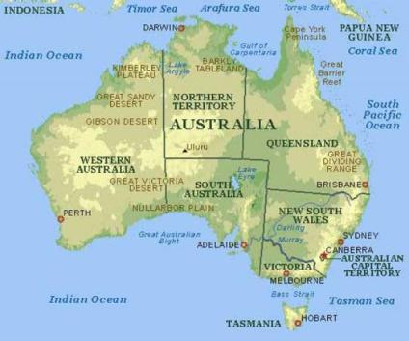
Australia
Australia is the only nation that occupies a whole continent. It’s an island of 7.7 million square kilometers. It is the six largest countries in the world after Russia, Canada, China, the United States of America and Brazil.

Slide 3
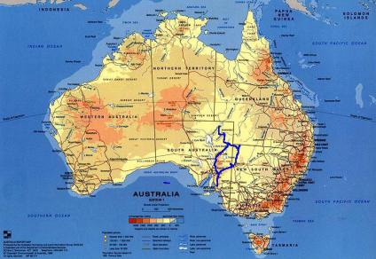
Australia
It is located to the south of Asia, between the Pacific and Indian oceans. Australia is the flattest continent after Antarctica. It is also the world’s driest continent.

Slide 4
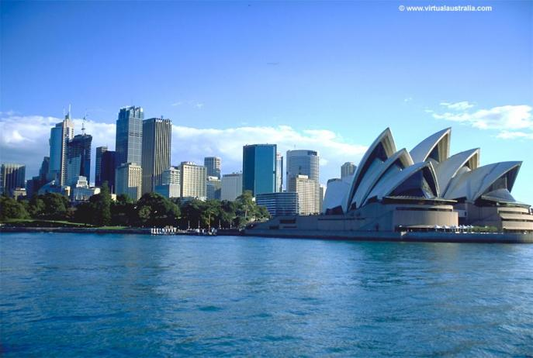
Australia
The climate of Australia is varied, from tropical in the north to temperate in the south-east. Australia is situated in the southern hemisphere. That is why it has summer when we have winter.

Slide 5
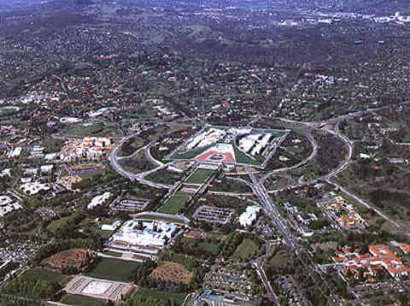
Australia
Canberra is the capital of Australia. It is not a biggest city. Sidney and Melbourne are much bigger.

Slide 6
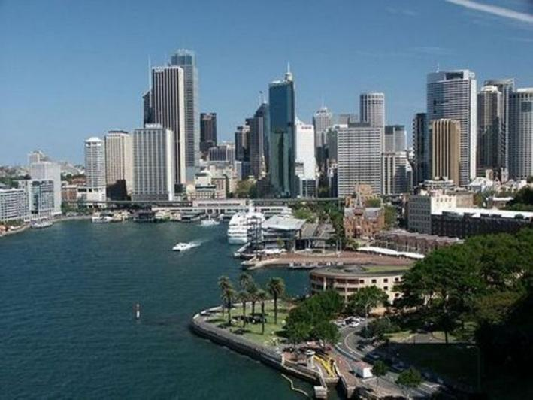
Australia
Australia’s official language is English. Australian English does not differ significantly from other forms of English, although some expressions are unique to Australia.

Slide 7
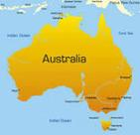
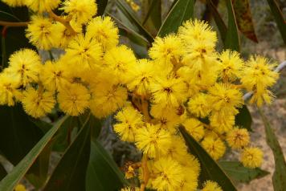
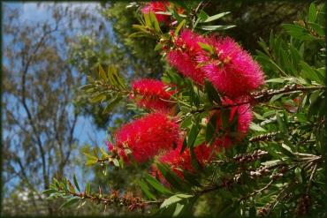
Australia
In 1984 Australia officially adopted green and gold as its national colors.

Slide 8
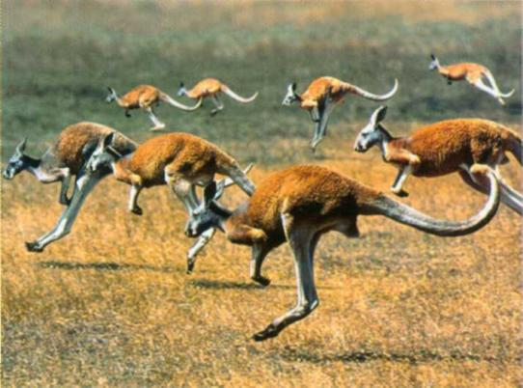
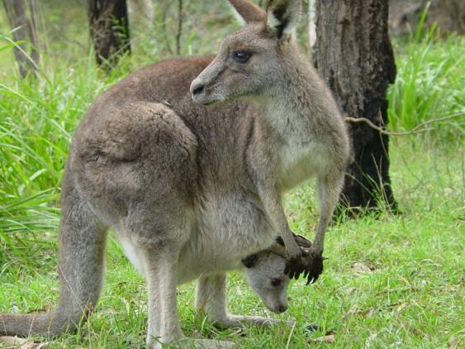
Australia
There are 50 species of kangaroo. Some stand as tall as a man and some are as small as a cat. They can often be seen in many of the forests and parks.

Slide 9
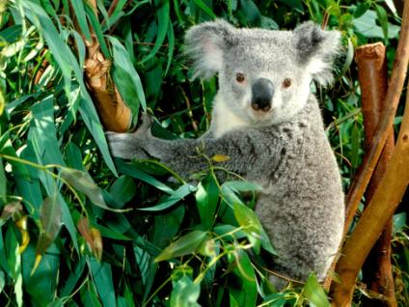
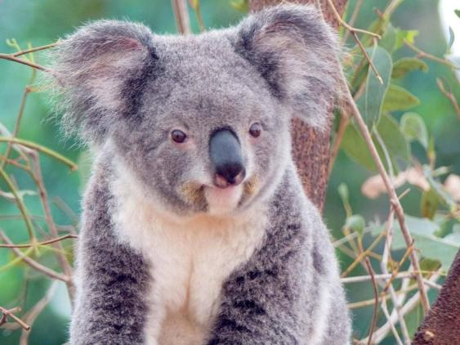
Australia
The koala is the best loved of all Australian animals. The koala lives on leaves alone.

Slide 10
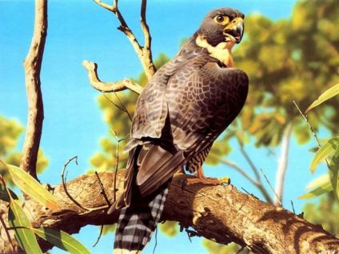
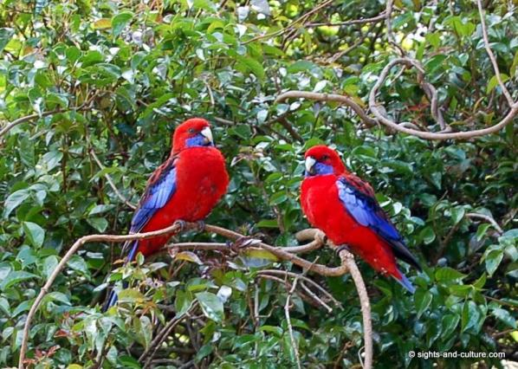
Australia
About 400 species of birds in Australia are found nowhere else in the world.

Slide 11
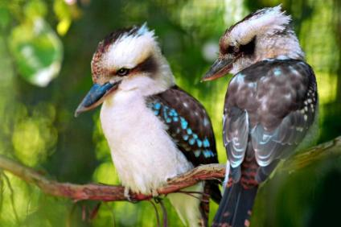
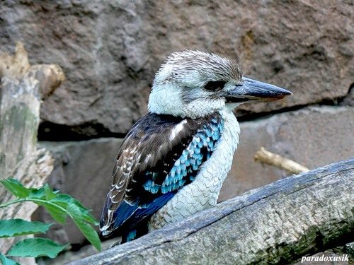
Australia
The kookaburra is another interesting Australia bird. It cannot sing, but laughs like a human.

Slide 12
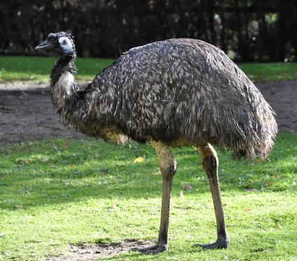
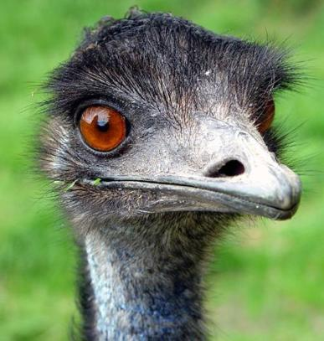
Australia
The emu is the most interesting bird in Australia. It is big and cannot fly.

Slide 13
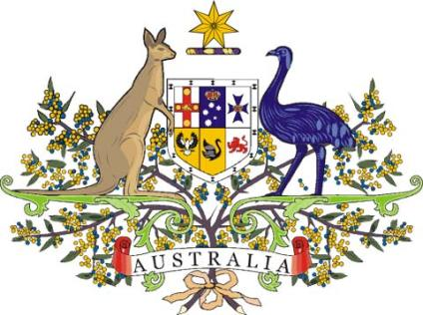
Australia
The kangaroo and emu can be seen on Australia’s coat of arms.

