Slide 1
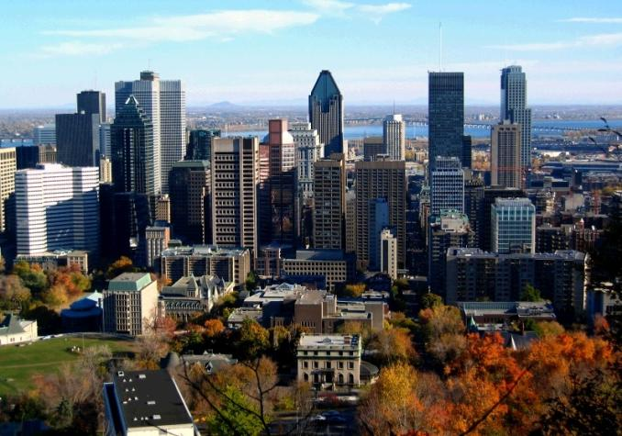
CANADA
Teacher: Lebedeva S.P.

Slide 2
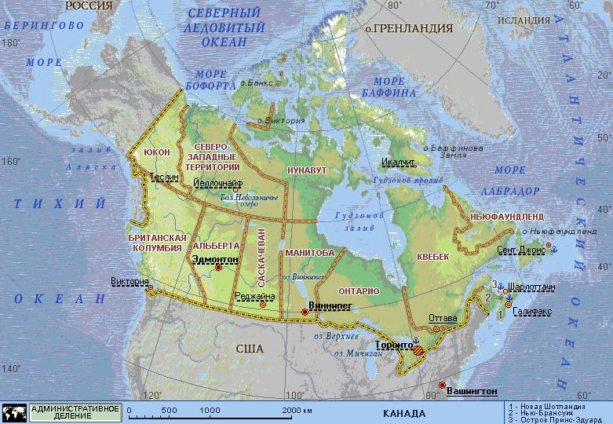
Geographical position
Canada is a North American country.
Located in the northern part of the continent, it extends from the Atlantic to the Pacific and northward into the Arctic Ocean.

Slide 3
Geographical position
Canada is the second largest country in the world. Only Russia has a greater land area. Canada is situated in North America. Canada is a federation of 10 provinces and 2 territories.

Slide 4
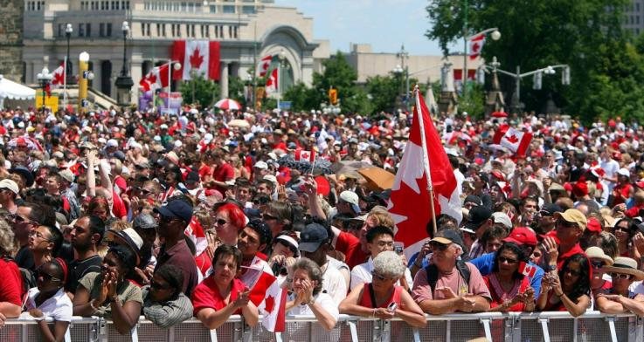
The population
Canada is slightly larger than the United States, but has only about a tenth as many people. About 28 million of people live in Canada. About 80% of the population live within 320 km of the southern border. Much of the rest of Canada is uninhabited or thinly populated because of severe natural conditions. Canada's people are varied. About 57% of all Canadians have some English ancestry and about 32% have some French ancestry.
Native people – American
Indians and Eskimos –
make up about 2% of the
country's population. 77%
of Canada's people live in
cites or towns.

Slide 5
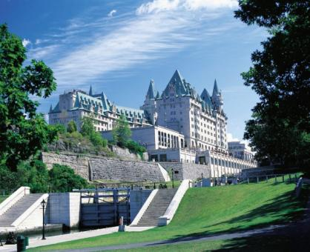
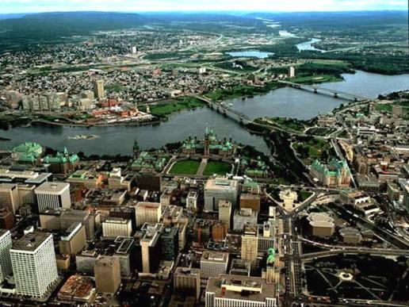
The Capital of Canada
Ottawa is the capital of Canada. One third of its people are French-speaking. Ottawa is the capital of Canada and is located on the banks of the Ottawa, Rideau and Gatineau rivers. Canada’s fourth-largest city is a complementary blend of urban and rural lifestyles, old and new neighborhoods, culture and heritage, business and government. Ottawa also has a high standard of living reflected in a multitude of accessible services, vibrant entertainment, exciting recreational activities, and thriving businesses.

Slide 6
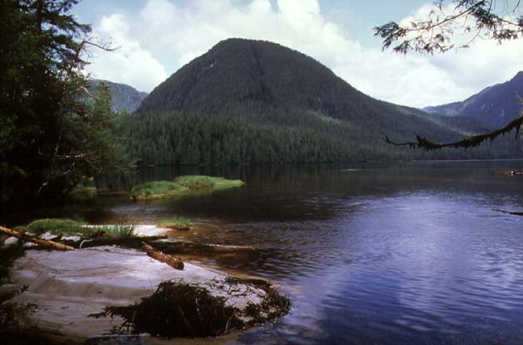
Canada's Great Lakes
Canada's Great Lakes are some of the largest and most beautiful in the world. The alpine towns sprinkled along the Rockies on the Alberta side are an unspoiled mountain playground where each season has its own unique beauty and selection of activities.

Slide 7
FLAG
The red and white Canadian flag shows a leaf of the maple tree, which grows in North America. The maple leaf is the official emblem of Canada. The official ceremony inaugurating the new Canadian flag was held on Parliament Hill in Ottawa on February 15, 1965, with Governor General Georges Vanier, Prime Minister Lester B. Pearson, the members of the Cabinet and thousands of Canadians in attendance.

Slide 8
National emblem
Early settlers are represented by the three royal lions of England, the royal lion of Scotland, the harp of Ireland and the fleur-de-lis of France.
The lion of England holds the British flag.
The unicorn of Scotland holds the flag of Royal France.
The bottom has the fleur-de-lis (France), the shamrock (Ireland), the thistle (Scotland), and the rose (England).

Slide 9
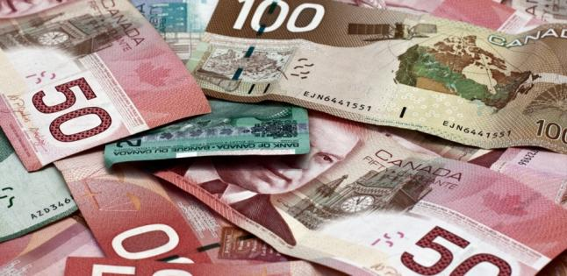
Economy
Canada is the world’s eleventh – largest economy. It is a member of the Organisation for Economic Cooperation and Development and the G8, and is one of the world’s top ten trading nations, with a highly globalized economy

Slide 10
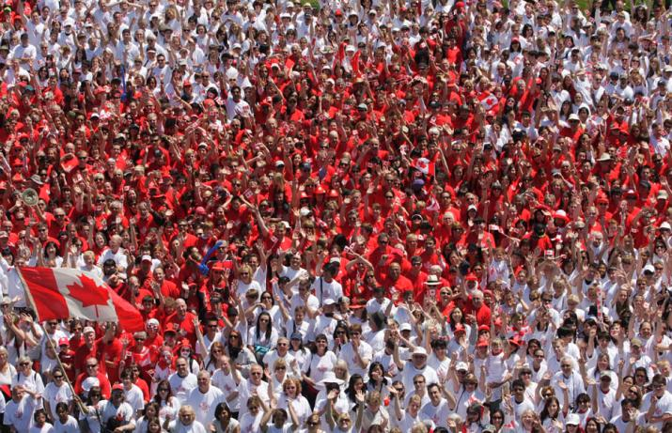
Languages
Official languages: English and French
Recognised regional languages: Chipewyan, Cree, Gwich’in, Inuinnaqtun, Inuktitut and etc.

