Slide 1
WHAT DO YOU KNOW ABOUT BRITAIN?

Slide 2
Check yourself
1. What is the official name of the country?
a) Britain
b) The United Kingdom of Great Britain and Northern Ireland
c) Great Britain
2. Name the capitals of England, Scotland, Wales and Northern Ireland?
a) Washington, London, Belfast, Cardiff
b) London, Edinburgh, Cardiff, Belfast
c) London, Paris, Belfast, Cardiff
3. What are the main colours of the Union Flag?
a) blue, red, white
b) red, green, white
c) blue, red, black
4. Who is the Head of the United Kingdom of Great Britain and
Northern Ireland?
a) Queen Victoria
b) Prince Charles
c) Queen Elizabeth II
5. The main river in the UK is …
a) the Thames
b) the Avon
c) the Severn
6. The symbol of England is …
a) white rose
b) red rose
c) daffodil

Slide 3
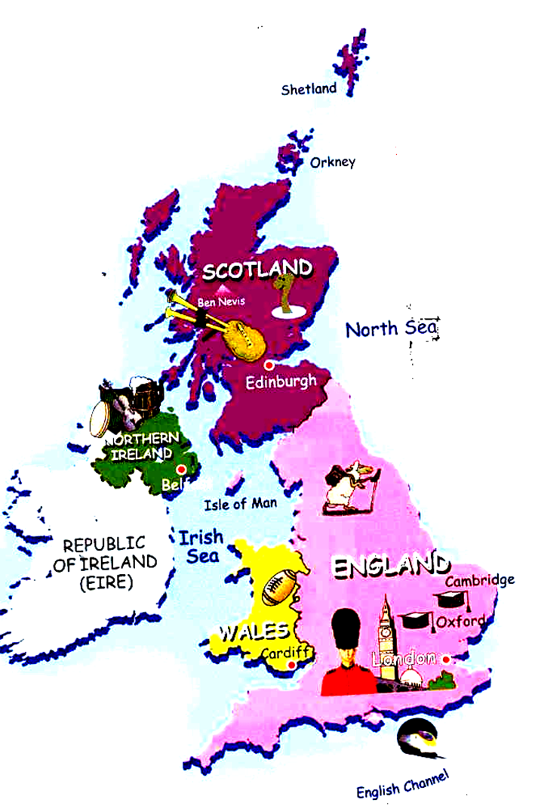

Slide 4
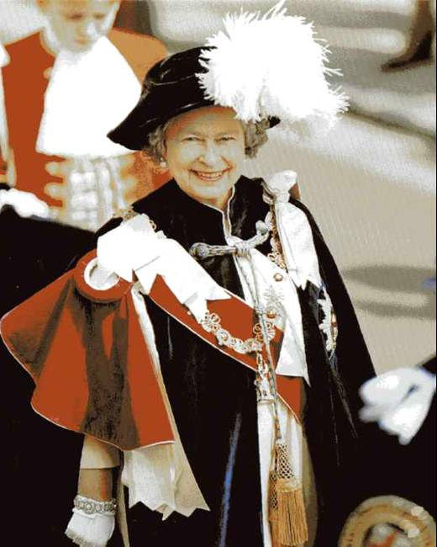
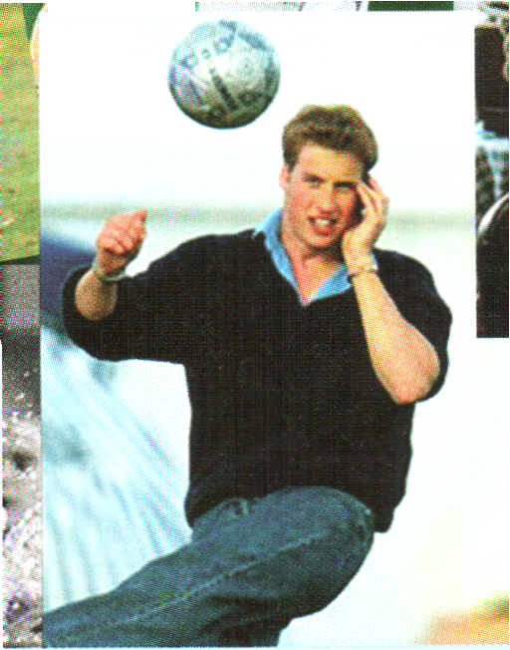
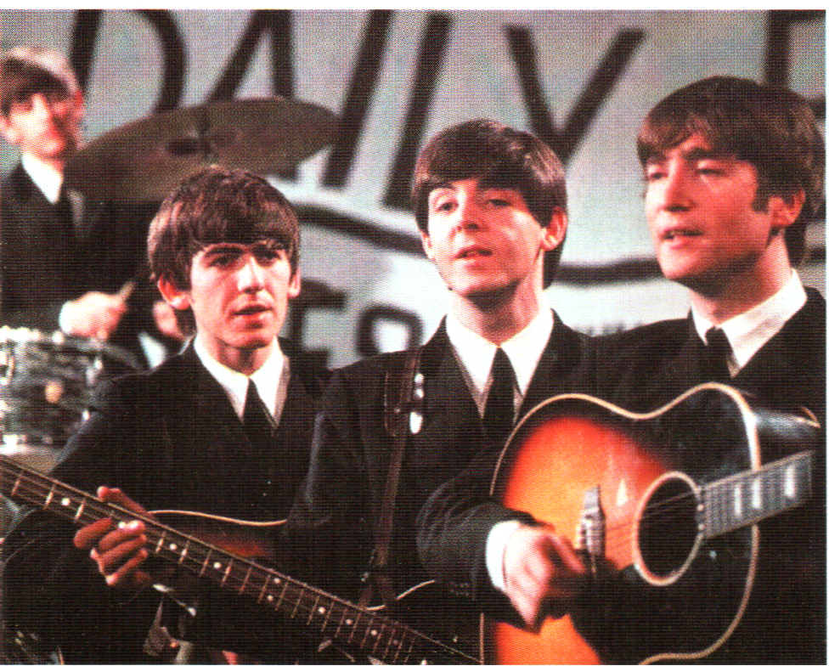
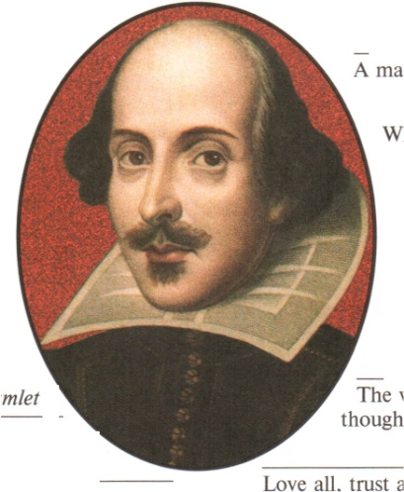
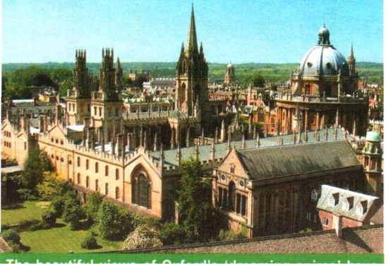
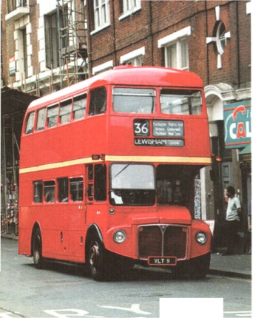
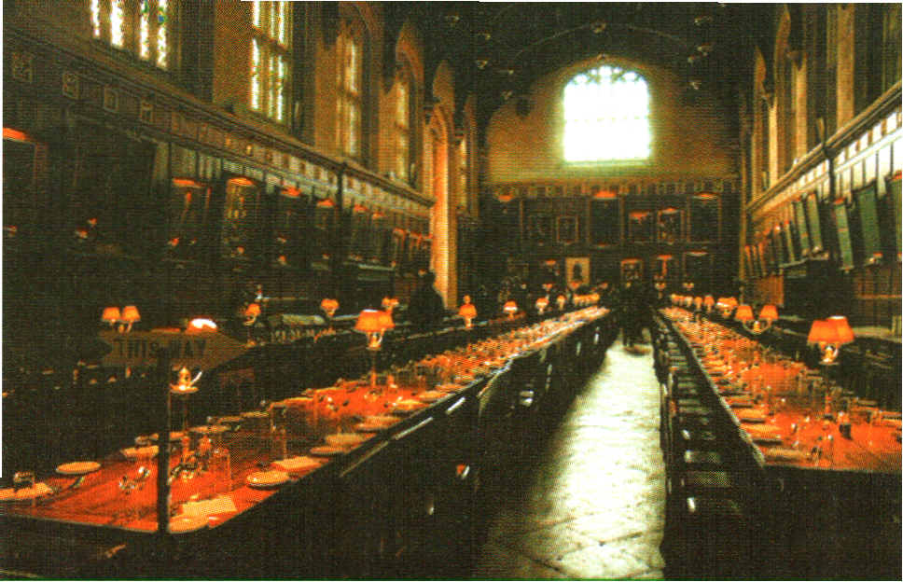
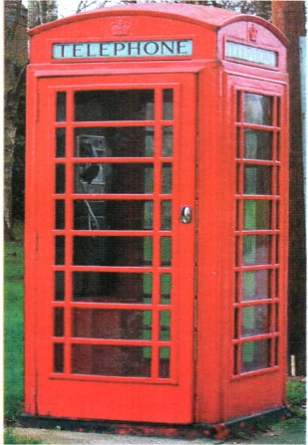
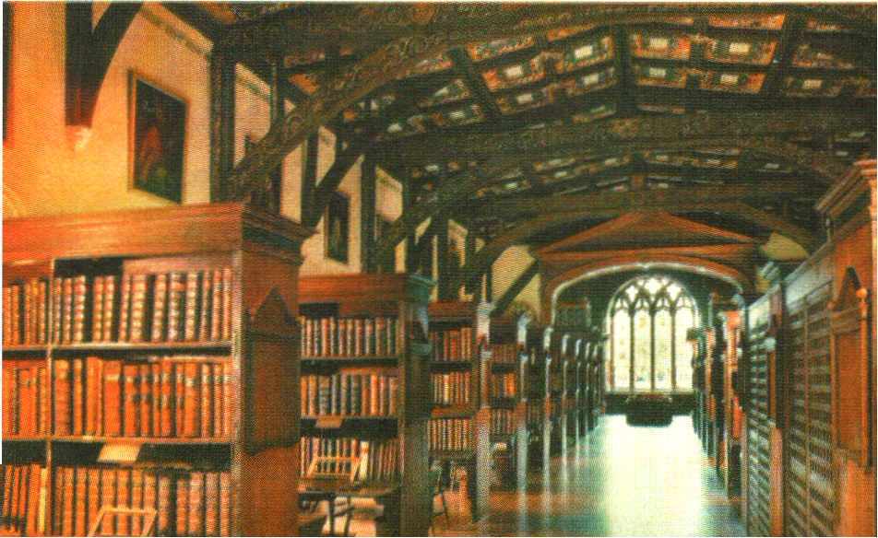
Do you know these faces and places?
Queen Elizabeth II
Prince William
“the Beatles”
William Shakespeare
Oxford
University
double-decker
bus
Oxford’s
dining hall
red
telephone
box
Oxford’s
library

Slide 5
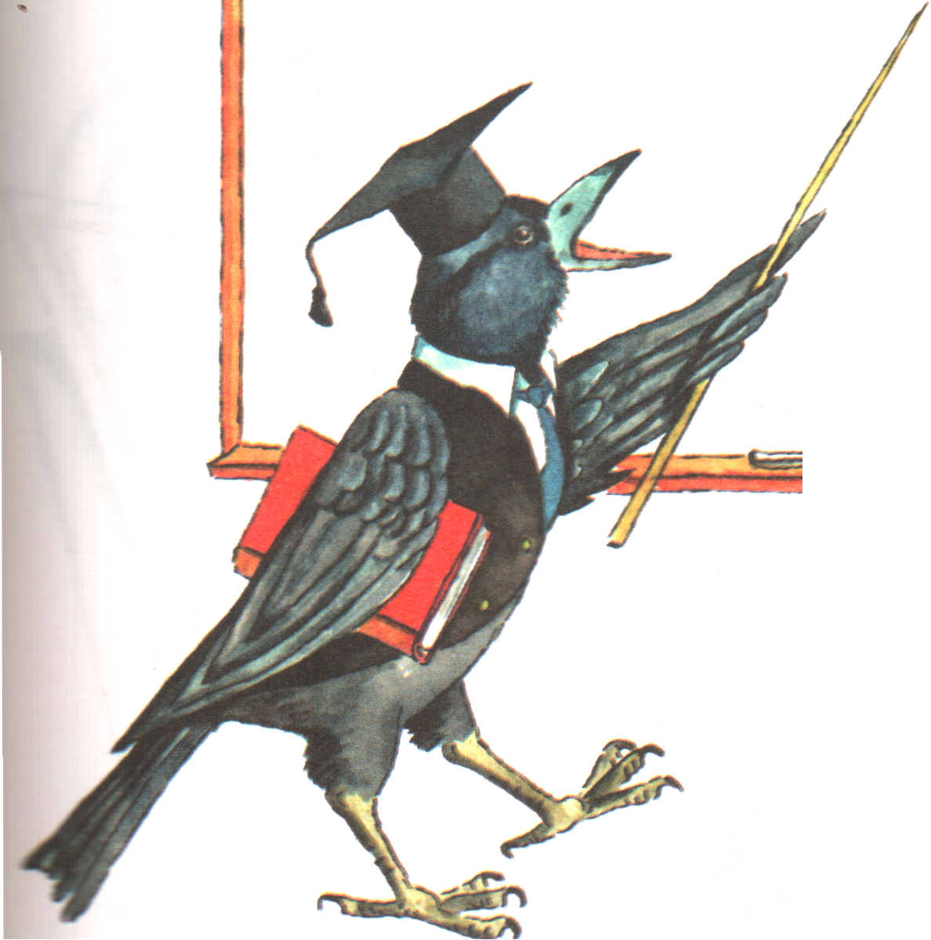
You are right!

Slide 6
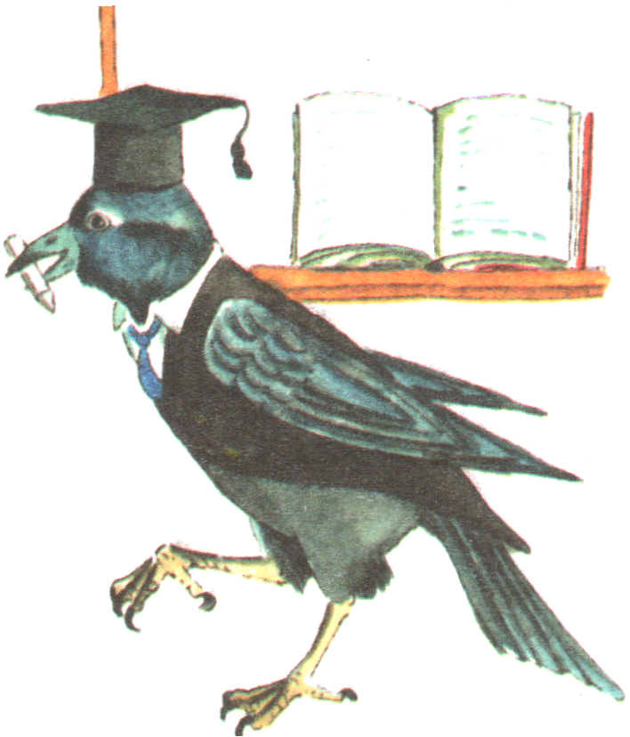
It is
wrong!
Try
again!

Slide 7
Do you know these holidays?
1. This is one of the most famous favourite holidays of the year. Children dress up, shout “Trick or treat”, get sweets, fruit, cakes and people have pumpkins with the candles in their windows.
2. On this day people give cards with hearts, presents and flowers to their boyfriend, girlfriend, husbands and wives. Some people do not put their names at the end of their cards because they want their name to be secret.
3. People celebrate this holiday in England and in America in the same way. People make jokes on this day and have a lot of fun. People celebrate this holiday in spring.
4. This is the biggest holiday of the year. Many people enjoy it most: of all and say this is the main holiday of the year. The President gives his speech on TV. Parents tell their children that Santa Claus will come to their house at night and leave presents for them.
Halloween
St. Valentine’s Day
April Fool’s Day
Christmas Day

Slide 8
PUZZLES
1. What is white when it is dirty and black when it is clean?
2. Give me food and I will live,
Give me water and I will die.
What am I?
3. Where can you find roads without cars, forests without trees and cities without houses?
4. What is black when you buy it, red when you use it, and grey when you throw it away?
(a blackboard)
(a fire)
(a map)
(a coal)

Slide 9
ENGLISH PROVERBS
1. Don’t look a gift horse in the mouth!
2. Don’t put your eggs in one basket!
3. Early to bed, and early to rise makes a man healthy, wealthy, and wise!
4. Don’t cross the bridge until you come to it!
5. Don’t put the cart before the horse!
6. A bird in the hand is worth two in the bush!
7. Easy come, easy go!
8. Silence is golden!
а) Как пришло, так и ушло!
b) Наперед батьки не лезь!
c) Дареному коню в зубы не смотрят!
d) Кто рано встает тому бог подает!
e) Не плюй в чужой колодец!
f) Не говори «гоп», пока не перепрыгнешь!
g) Лучше синица в руках, чем журавль в небе!
h) Молчание – золото!

Slide 10
THE LESSON IS OVER.
GOOD – BYE!

