Slide 1
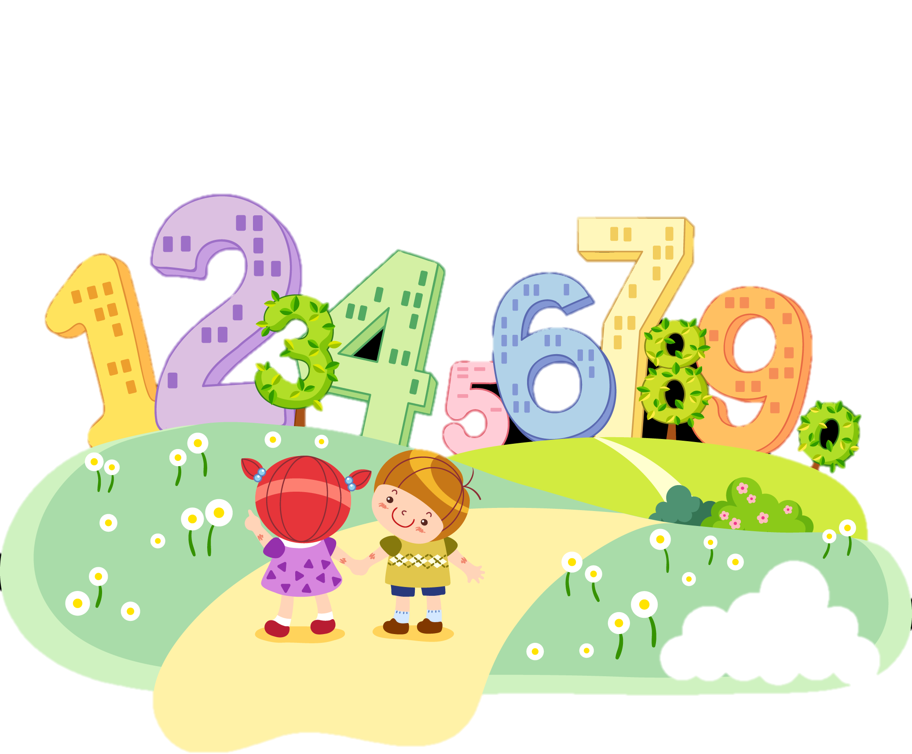
Математическая логика

Slide 7
Сколько стоит чашка?

Slide 9
20, 18, 19, 17, 18, 16, 17, ...., ....,
1, 2, 4, 7, 11, 16, 22, 29, ...., ....
24, 21, 19, 18, 15, 13,…,…., 7
1, 4, 9, 16,…,…, 49, 64
16, 48, 17, 51, 18, 54, ……, …..
(15, 16)
(37,46)
(12, 9)
(25, 36)
(19, 57)

Slide 18
