Slide 1
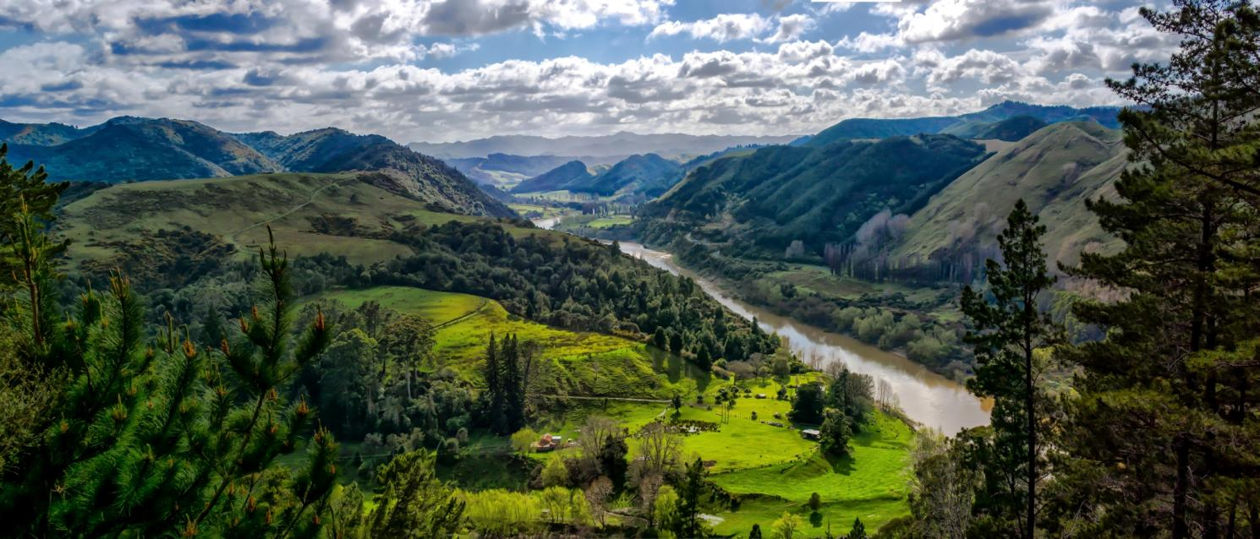
New Zealand
Teacher: Lebedeva S.P.

Slide 2
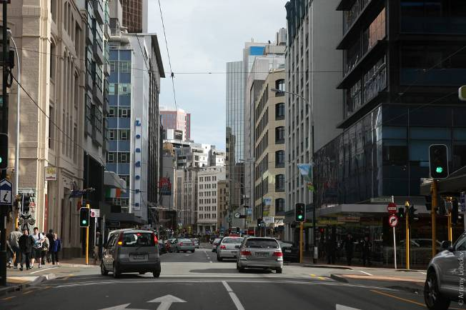
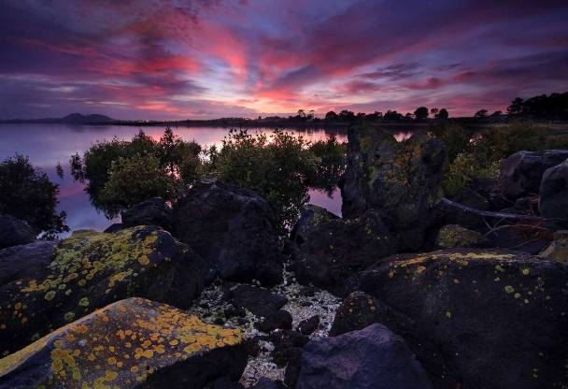
New Zealand is an island nation, situated between the Equator and the South Pole in the southern Pacific Ocean. It is situated the same distance east from Australia as London is from Moscow. The distance between the two countries is about 1,600 kilometres. The countries are separated by the Tasman Sea.

Slide 3
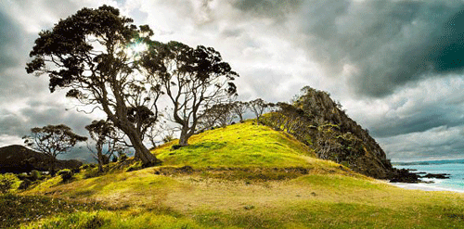
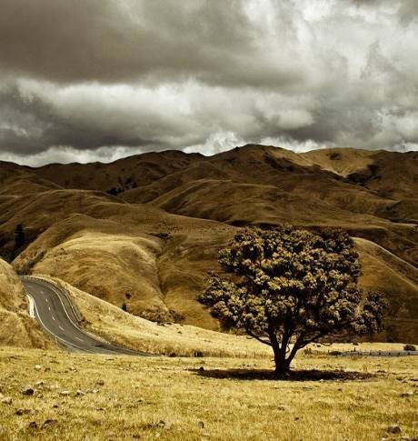
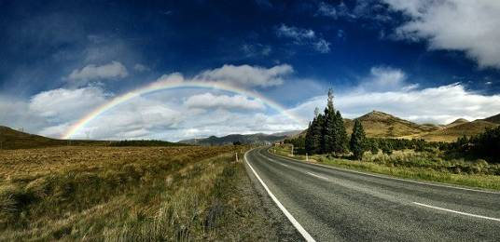
New Zealand includes two main and a number of smaller islands. Each of the two main islands (North and South Islands) is hilly and mountainous. The main mountain ranges are on the South Island and include the Southern Alps, in which 20 peaks exceed 3,000 metres. The highest peak is Mount Cook on South Island.

Slide 4
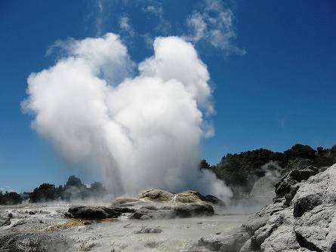
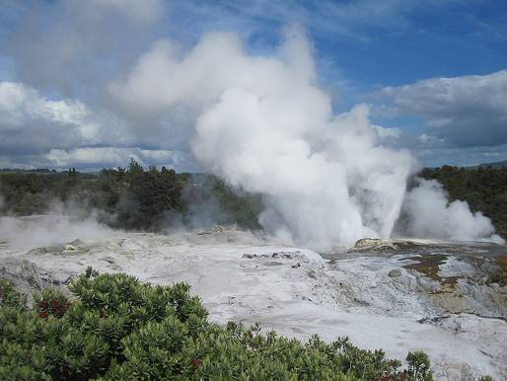
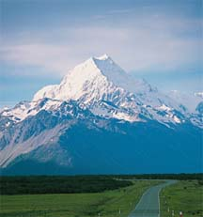
A volcanic plateau is in the centre of North Island. There are three active volcanoes in North Island, and the Rotorua district is known for its geysers and hot springs. Earthquakes are frequent there.

Slide 5
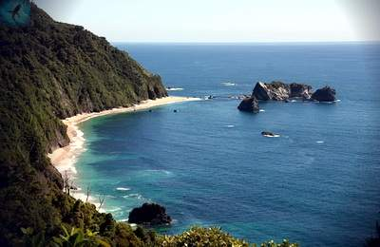
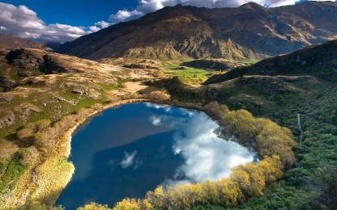
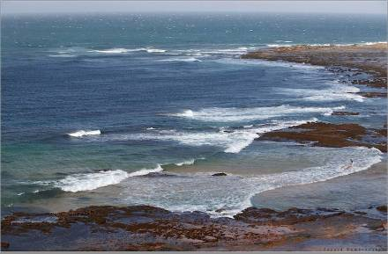
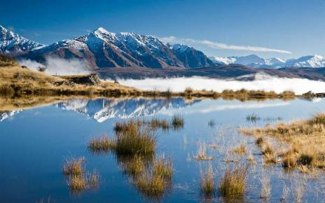
New Zealand has an oceanic climate, without extremes of heat or cold. Snow is common only in the mountains. The eastern lowlands include the driest and sunniest climates.

Slide 6
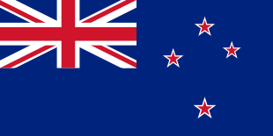
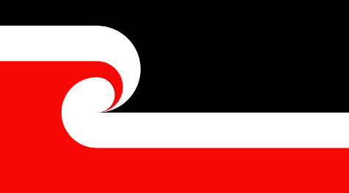
The Flag of New Zealand is a defaced blue ensign with the Union Flag in the canton, and four red stars with white borders to the right. The stars represent the constellation of Crux, the Southern Cross, as seen from New Zealand. The flag proportion is 1:2 and the colours are Red, Blue and White. Proportion and colours are identical to the Union Flag.
Since 1990, some Māori have been using the red ensign less in favour of a new flag which lacks colonial connotations. Chosen through a competition, the Māori flag uses black to represent Te Korekore or potential being, white to represent Te Ao Marama or the physical world, red to represent Te Whei Ao, the realm of coming into being and the Koru, a curl representing the unfolding of new life.

Slide 7
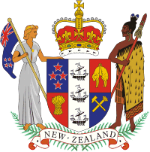
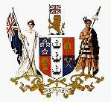
Until 1911, New Zealand used the same national coat of arms as the United Kingdom. When New Zealand became a Dominion in 1907, it was decided that a new Coat of Arms was required, and a design competition was held. Since being granted its own arms in 1911, New Zealand's arms have remained similar to the current design, with minor changes in 1956. The shield is now supported by two figures, a blonde Pākehā (European) woman holding the New Zealand flag, and a Māori warrior holding a taiaha (Māori staff). The shield is topped with the St Edward's Crown, and beneath the shield are two silver fern leaves and a scroll bearing the words "New Zealand".
The old-style Coat of Arm

Slide 8
New Zealand is an independent state and a member of the Commonwealth. The British monarch is head of state, represented by Governor General. As in Great Britain, the legislature is called the Parliament. In New Zealand the Parliament consists of a single chamber, the House of Representatives. Its member are elected every three years. There are 120 member in the House of Representatives. The leader of the party in power becomes the Prime Minister, who heads the formal Executive Council. There are 38 government departments in the country. Most ministers have charge of more than one department.

Slide 9
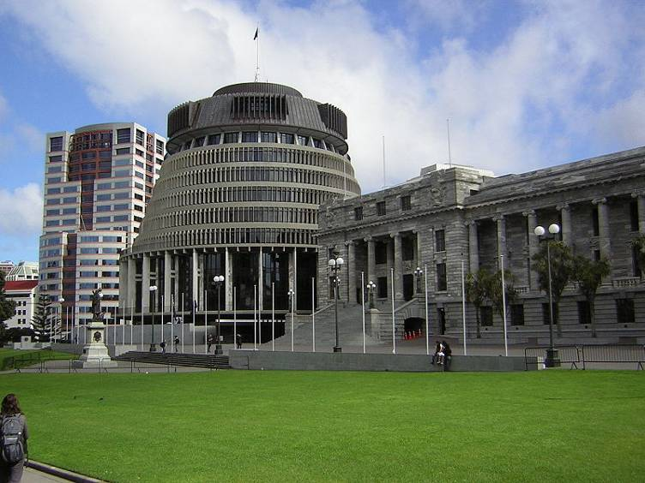
The Parliament seats in Wellington in the building which is called the Beehive because of its form. The Prime Minister’s residence in Wellington is known as Vogel House.

Slide 10
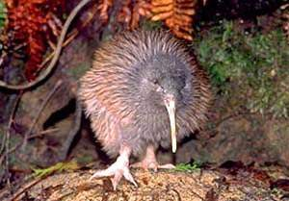
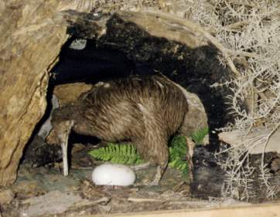
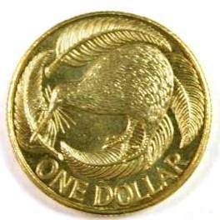
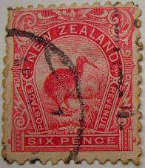
National Emblem
The kiwi bird was named so for the sound of its chirp. This flightless bird, about the size of a domestic hen, has an extremely long beak and plumage more like hair than feathers. It has no tail, almost no wings. It weights about 2 kg. The female kiwi lays only one egg, but it is about 1/5th of her own weight. After laying it she leaves her husband to hatch the egg out. The New Zealand dollar is frequently called the Kiwi. The dollar coin features a kiwi bird on one side.

Slide 11
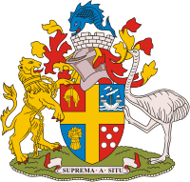
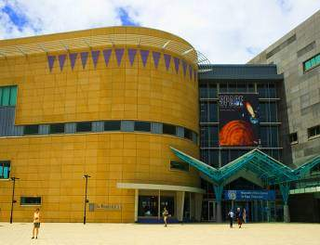
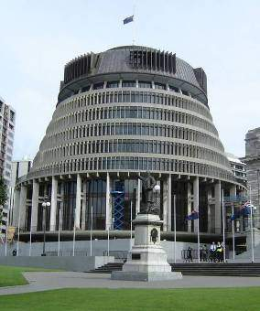
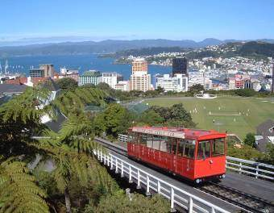
Wellington
Te Papa Museum
Wellington is the capital of New Zealand, the country's second largest urban area and the most populous national capital in Oceania. The population is about 449,000 people. Wellington is New Zealand's political centre, housing Parliament and the head offices of all government ministries and departments, plus the bulk of the foreign diplomatic missions based in New Zealand.
Wellington Parliament

Slide 12
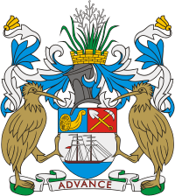
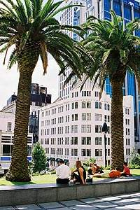
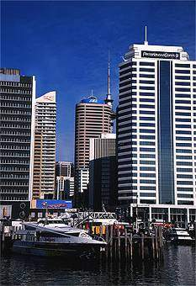
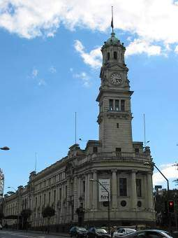
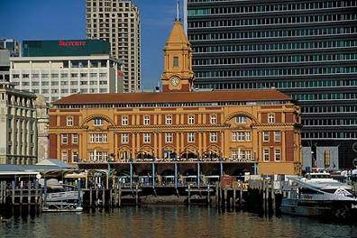
Auckland
Chancery
Auckland is the largest urban area of the country. With over 1,260,900 people it has over a quarter of the country's population.
Skyline
Town Hall
Auckland Waterfront

Slide 13
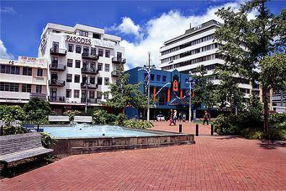
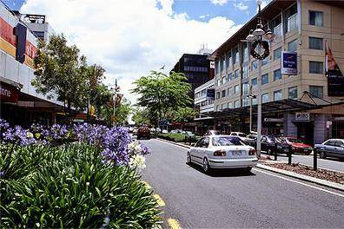
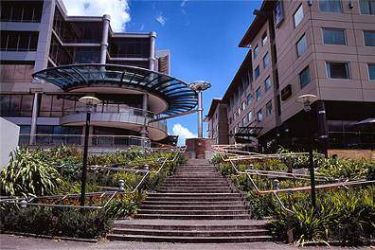
Hamilton
Hamilton is the country's 7th largest city. The population is 187, 960 people. It is in the Waikato region of the North Island. It sits on both banks of the Waikato River. The city is host to a large number of small galleries and the Waikato Museum. Hamilton is home to more than 25,000 students, mostly enrolled in one of the city's two main institutes, the University of Waikato and Waikato Institute of Technology.
City Plaza
Victoria Street
Novotel Tainui

Slide 14
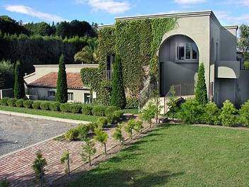
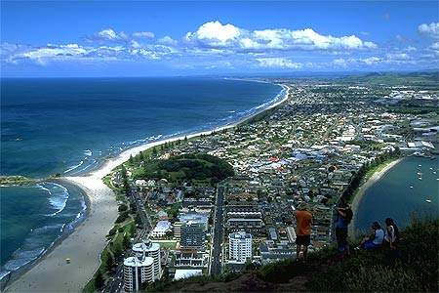
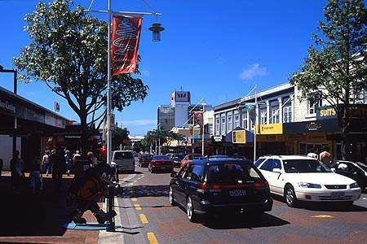
Tauranga
Tauranga is the largest city of the Bay of Plenty region. The Population is about 109,100 people. It is the 9th largest city area in the country, and the centre of the 6th largest urban area.
The House
Town Centre
View of Town

Slide 15
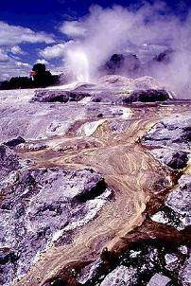
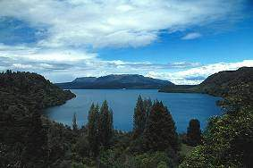
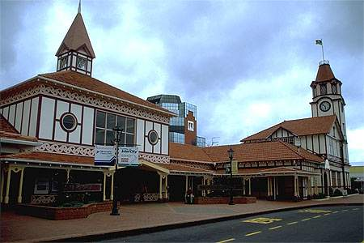
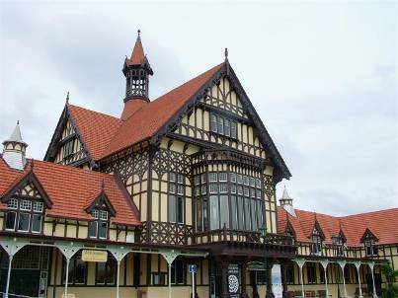
Rotorua
Geyser
Rotorua is a town on the southern shore of Lake Rotorua in the Bay of Plenty region. The city has a population of 53,000, of which one third is Māori. Rotorua is well-known for geothermal activity. There are a number of geysers, notably the 20-m Pohutu geyser at Whakarewarewa, and hot mud pools located in the city, which owe their presence to the Rotorua caldera.
Lake
Visitors Centre
Bath-House

Slide 16
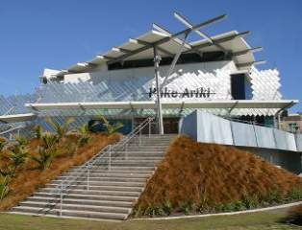
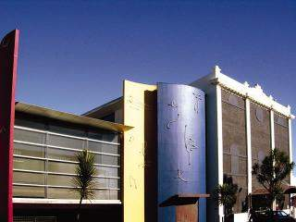
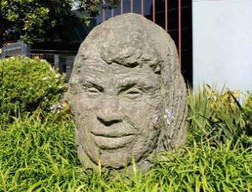
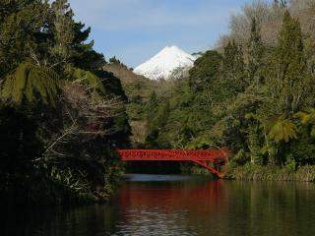
New Plymouth
Striking Candmark
Govett-Brewster Art Gallery
New Plymouth is the port and main city in the Taranaki region. The population is about 49,500 people. The city is a service centre for the region's principal economic activities. It is also a bustling financial centre as the home of the TSB Bank.
Pakekura Park
Civil Centre’s Entrance

Slide 17
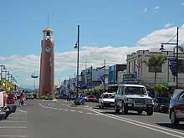
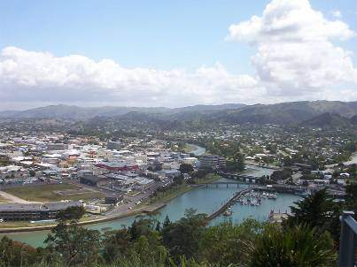
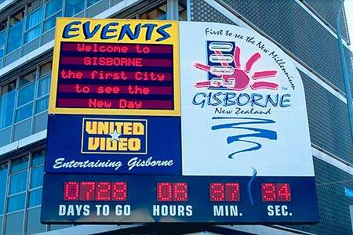
Gisborne
Gisborne is the name of a unitary authority in New Zealand, being both a region and a district. The population is about 32,700 people. Gisborne is named for an early Colonial Secretary William Gisborne. The council is located in the city of Gisborne.

Slide 18
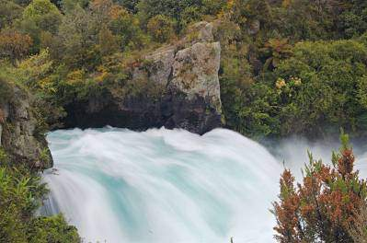
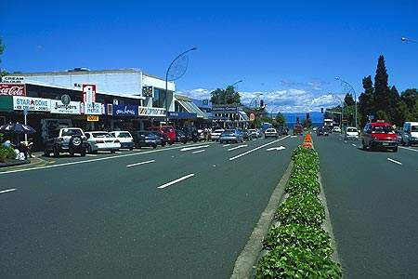
Taupo
Taupo is a small urban area in the centre of the North Island. It is the seat of the Taupo District Council. Taupo has a population of 22,300.Taupo is located at the north-east corner of Lake Taupo, and functions as a tourist centre, particularly in the summer, as it offers panoramic views over the lake and the volcanic mountains of Tongariro National Park to the south. One of New Zealand's most spectacular waterfalls, the Huka Falls is also close to the town.
Huka Falls
Main Road
Lake

Slide 19
South Island
The South Island is the larger of the two major islands of New Zealand. The South Island has an area of 151,215 sq. km, making it the world's 12th-largest island. It has a population of 991,100. Along its west coast runs the mountain chain of the Southern Alps with Mount Cook being the highest point, 3,754 m.

Slide 20
Cathedral
Christchurch
Christchurch is the regional capital of Canterbury. The largest city in the South Island, it is also the second largest city and third largest urban area of New Zealand. The Population is about 367,700 people. The city is named after the Christ Church cathedral, which is itself named after Christ Church, a college at the University of Oxford, and the Cathedral of Oxford. The city was originally known as Christ Church, the written form consolidating by the 1880s.
Museum
College

Slide 21
Dunedin
Cathedral
Dunedin is the second-largest city in the South Island, and the principal city of the region of Otago. The population is about 114,700 people. It is New Zealand's fifth largest city in terms of population. For historical and cultural reasons, Dunedin is considered one of the country's four main centres. The city stands on the hills and valleys surrounding the head of Otago Harbour. The harbour and hills are the remnants of an extinct volcano. It is the home of the University of Otago.
Railway Station
Cathedral

Slide 22
Cathedral Step
Nelson
The City of Nelson is the administrative centre of the Nelson region. The population is about 60,500 people. Nelson received its name in honour of the Admiral Nelson. Nelson is a centre for arts and crafts, and each year hosts popular events such as the Nelson Arts Festival.
Hardy Street
Trafalgar Street

Slide 23
Queenstown
Queenstown is a picturesque tourist destination located in the South Island. The population of the Queenstown is 9,251. The town is built around an inlet on Lake Wakatipu. Queenstown is the adventure capital of the world. Many tourists flock to the area year round to indulge in activities such as white water rafting, kayaking, jet boating, tandem sky-driving.

Slide 24
Picton
High Street
Picton is the gateway to the South Island. The town's main purpose is to cater for the travellers who arrive or depart the ferry service that runs between both the North and South islands. Picton is a small town, but is busy as travellers prepare to explore the area or strike out further a field to the nearby Nelson or Canterbury regions. The population is about 4,200 people.
Queen Charlotte Sound

Slide 25
Birds
There are some 70 species of birds found nowhere else in the world, more than a third of them are flightless, and almost a quarter of them nocturnal. Notable New Zealand birds include the Tui, Bellbird, Kiwi, Kakapo, Takahe, and Weka. New Zealand is also home to many seabirds including the Albatross, which has the longest wing span of any bird in the world. The most spectacular of all New Zealand birds was the Moa. Some Moa's reached heights of 15 feet, making them the tallest bird in the world.
Takahe
Moa
Kakapo
Weka

Slide 26
Plants
Cabbage Tree
New Zealand is one of the world’s richest bio-diverse flora areas on earth. It is endemic and its extent is enormous. Native trees include Rimu, Totara, Matai, Kahikatea, Rata, Tawa and many species of ferns including some giant tree ferns. Other notable trees include the Cabbage Tree, the Nikau Palm which is New Zealand's only palm tree, and the Giant Kauri, which hold the record for the greatest timber volume of any tree. One of the most noticeable plants is the Pohutukawa which detonates with brilliant red flowers around December.
Rata
Nikau Palm
Pohutukawa
Fern

Slide 27
Animals
With the exception of two species of bat, no indigenous mammals are native to New Zealand. Wild mammals include deer, goats, pigs, rabbits, weasels, ferrets. Marine mammals are dolphins, seals and whales. New Zealand contains no snakes and has only one poisonous spider called the Katipo. Other insects include the Weta one species of which may grow as large as a house mouse and is the heaviest insect in the world. New Zealand's most unigue animal is the Tuatara, which is a lizard-like reptile that predates the Dinosaur and is considered a living fossil.
Tuatara
Katipo

Slide 28
National Parks
Abel Tasman NP
Whanganui NP
Paparoa NP
Mount Aspiring NP

Slide 29
New Zealand’s dairy industry is considered to be the most efficient. The export of dairy products is the largest in the world despite the country’s small size and population. Other industries are textiles, machinery, fish, forest products. Agriculture is highly industrialized. New Zealand is often called the sheep farm of Great Britain.

Slide 30
NATURE

