Slide 1
St. Valentine’s Day
Teacher: Lebedeva S.P.

Slide 2
Valentine’s Day is one of the most favorite holidays in the UK and the USA. They celebrate this holiday on February 14.
It is a day of love and friendship

Slide 3
To the teacher & every friend of mine
I’ll send a lovely valentine
Mom, dad, sister, brother too
Will receive a heart that says
I love you!

Slide 4
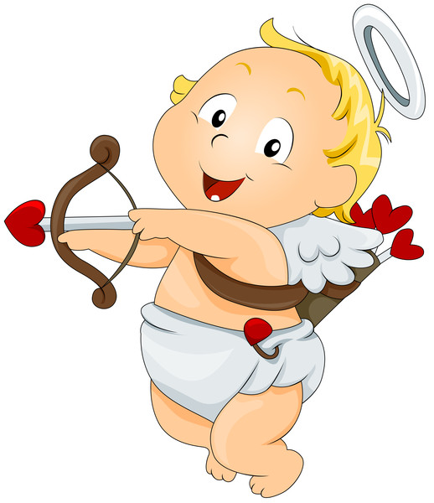
beautiful a. thin
fat b. new
big c. low
high d .clean
old e. small
dirty f. ugly

Slide 5
Beautiful - ugly
Fat – thin
Big – small
High – low
Old – new
Dirty - clean

Slide 6
The rose is red
The violets are blue
Lilies are fair
And so are you
Roses are red
Grass is green
You are the nicest
girl (boy)
I have ever seen

Slide 7
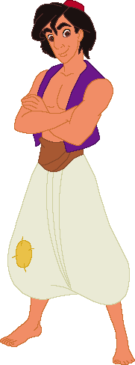
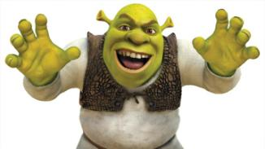
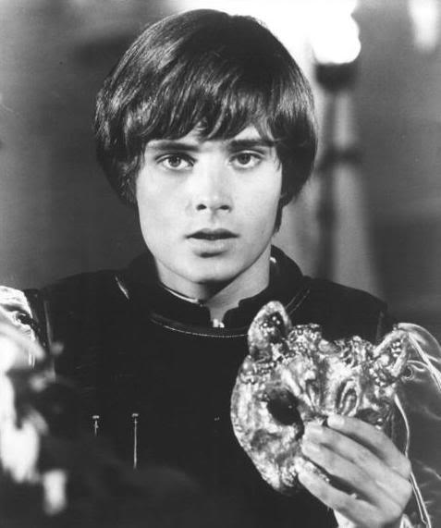
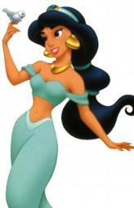
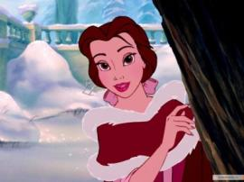
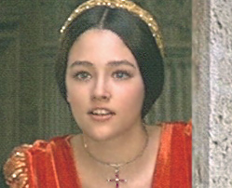
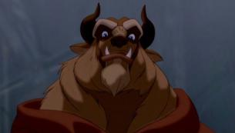
ROMEO FIONA
JASMIN JULIET
SHREK BURATINO
BEAUTY ALLADIN
MALVINA BEAST

Slide 8
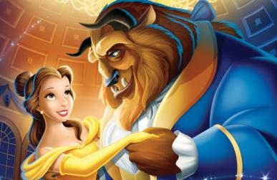
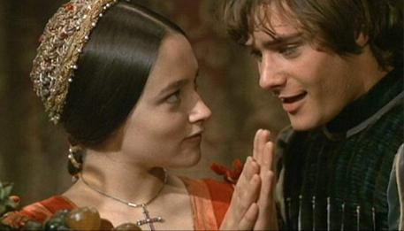
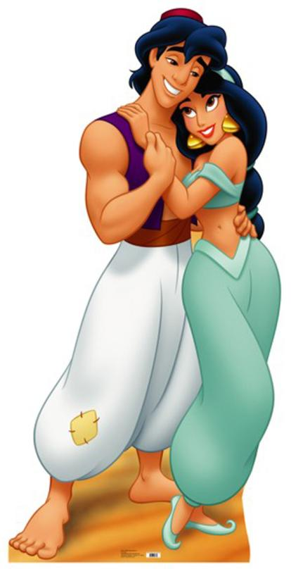
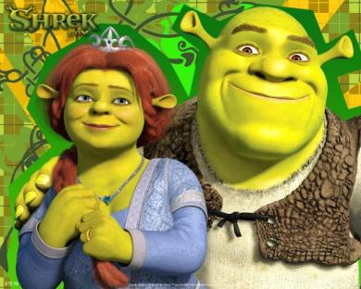
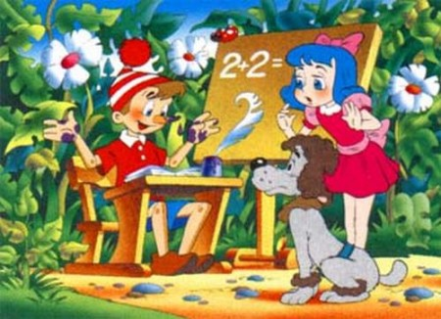
BEAUTY & BEAST
ROMEO & JULIET
SHREK & FIONA
ALLADIN & JASMIN
BURATINO & MALVINA

Slide 9
... is the holiday of lovers.
a) May Day
b)St. Valentine’s Day
c) All Fools' Day
St Valentine’s Day comes on …
February 14th
31st of December
25th of February
The main symbol of this holiday is…
А) eggs
b) turkey
c) valentine card

Slide 10
4) … are favourite presents which sweethearts send to each other
a) flowers and sweets
b) sandwiches
c) trees
5) Valentines are special greeting …
a) copy-book
b) exercise book
c) card
6) The … colour is a symbol on this day
a) green
b) red
c) yellow

Slide 11
1) epsnret ( present)
2) aetnVlnie (valentine)
3) eruyFbar (February)
4) vole (love)
5) iferdn (friend)
6) siks (kiss)
7) dre (red)

