Slide 1
My T-shirt is blue and my hat is pink,
My trousers are yellow,
my socks are green, My jacket is purple, my shoes are white. My gloves are brown, My scarf is black. Tell me, what do you think? Do you like the clothes I’m wearing? Do you think they’re good or bad? Or do you think I just look mad !!!

Slide 2
Shopping for clothes

Slide 3
Do the exercise
Watch the video

Slide 4
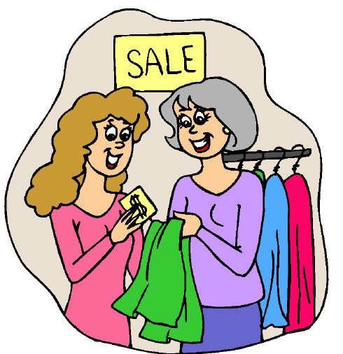
Are you ready to go shopping for clothes in the English speaking country?
1. YES! I know how to talk
with a shop-assistant.
2. I am not sure,
but I think I will do my best.
3. No! It is too difficult for me to speak with a shop-assistant and ask something about clothes.

